Slide 1


Help your customers become more successful at work!
Integrating personalized A.I for calendar events, email and social networking sites in your workspace.

Slide 2
Use case
Optimizing your email management with a Smart Assistant

Slide 3
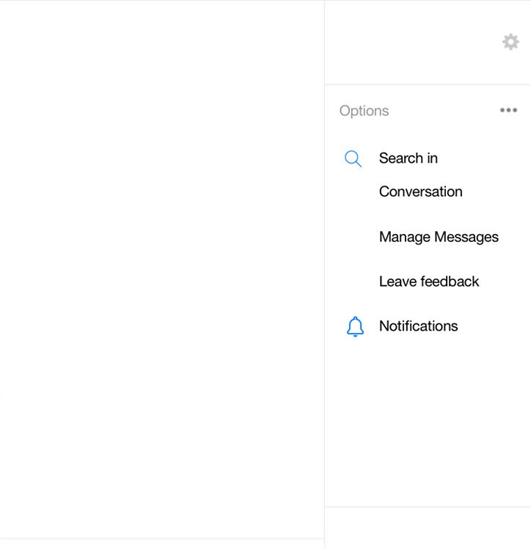
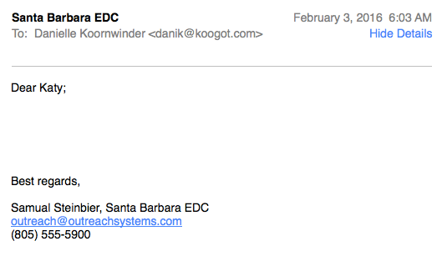



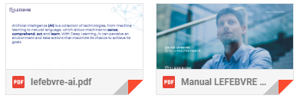
“Referring to my case of divorce” from
Samual Steinbier required information
and look unsatisfied.
Do you like to send a email with the
latest updates about the case?
AI assistant
Active on LEX-ON
Referring to my case of divorce
Yes
No
I attach the requested documents.
I am very sad because I've been waiting for a long time.
Could you please give me some information about my case?
Remind to meet with Samual Steinbier tomorrow at 14:00h
Reminder set for 14:00 pm friday,
February 24.
Thank you!
“Referring to my case of divorce” from
Samual Steinbier attach documentation.
Do you like to archive attachments in
the case folder?
Yes
No
No
You´re a life saver

Slide 4
How it works

Slide 5
LEARN improve performance (quality, consistency, and accuracy)
01
02
03
SENSE
Perceive the world by acquiring and processing images, sound and speech.
COMPREHENDS
Analyze and understand the information collected by adding meaning and insights.
ACT
Take action in the physical world based on comprehension and understanding.

Slide 6




SENSE
Receive events from your channels and transform the data into workable text
ACT
Based of the compression of the calendar events or emails content,
Defined required follow up action:
Reactive interactions
System advisor
Continuous workflow
Chatbot and virtual assistant on your favorite communication tools
A voice-enabled and cross-device intelligent assistant
COMPREHEND
Understand the content. For example categorize email and extract features
LEARN
Smart solution on-the-go for iOS and Android
Leverage Machine Learning to learn and improve the accuracy and correctness of the solution

Slide 7
The 4 steps of the first POC
STEP 4
STEP 3
STEP 2
ACT Using AMQP protocol (IoT architecture) to send events and take actions based on the NPL perception or compression.
STEP 1
NLP - Dialogflow Use machine learning to understand what the features are saying or meaning. And sentiment classification to identify critical information that allows to know the customer satisfaction
Analyzing text with
TF-IDF Term frequency–inverse document frequency is a numerical statistic that is intended to reflect how important a word is to a document in a collection or corpus. Necessary to get the top terms (features) of the email
Loading in the data
Extract data from the mail inbox to a CSV file and export into readable DataFrame

Slide 8

Thanks!
a.valverde-ext@lefebvre.es | +34 608 837 254 | lefebvre.es

Slide 9

©2020 Lefebvre. All rights reserved

